Slide 1
Entity Relationship Diagrams
Data Models
Categories of Data Models
Database Design
ER Approach
Roles
Relationship Constraints

Slide 2
ER Model – High Level Conceptual Model
The basic object in the E-R model is an entity which is a thing in the real world with an independent existence e.g. a person, a car, a department
Each entity has properties called attributes that describe it
  Each entity will have a value for each of its attributes:
  Name: Fred Elliot
  Address: 10 Coronation Street, Manchester, M10 11
    Age: 50
    Phone: Weatherfield 312000
Person entity type

Slide 3
Attributes
Attributes can be subdivided into subparts
  E.g. Address – street, town, county and postcode.
  These are called composite attributes
  Others called atomic attributes
Most attributes have a single value, e.g, DOB
Some attributes have a set of values, e.g., qualifications and are called multi-valued.
Some are derived, e.g, age from a DOB, number of employees
Attributes may have the special value null this means 'not known' or 'not applicable'. Null is semantically different from 'spaces' or zero

Slide 4
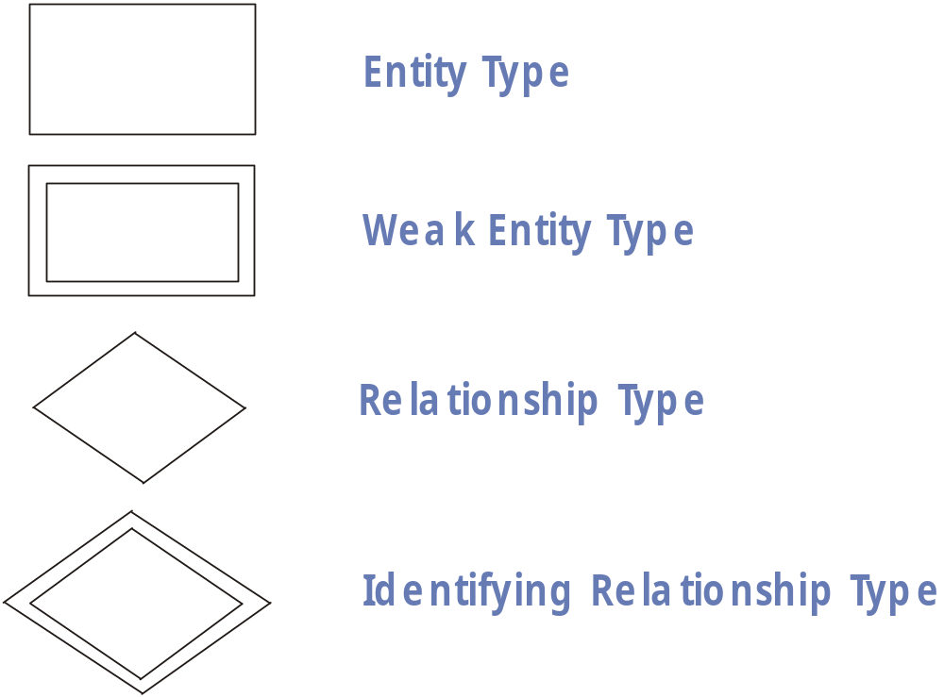
ER Diagramming – New notation

Slide 5
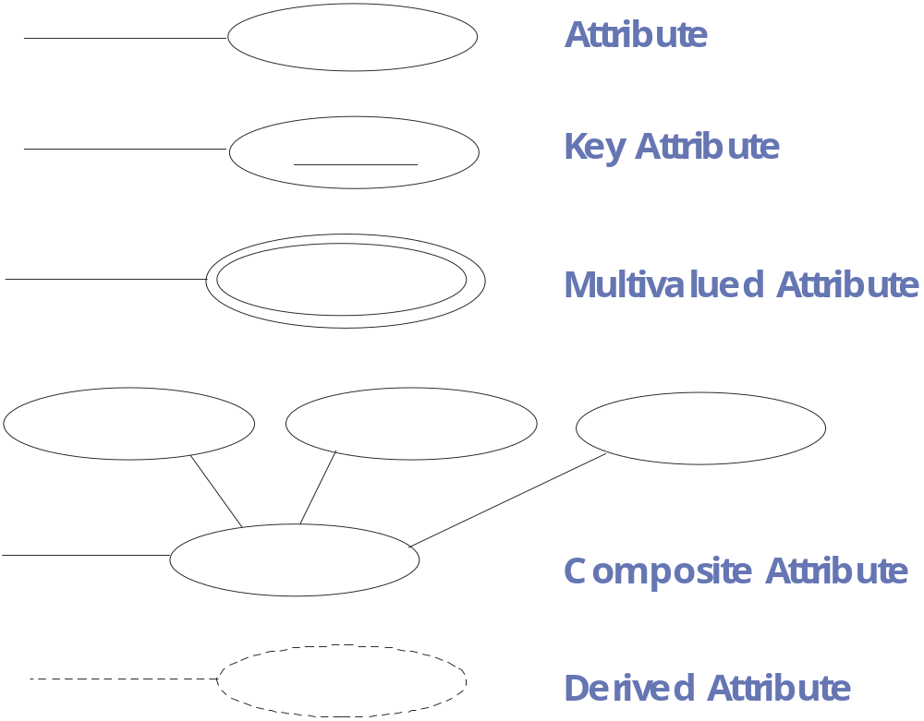
ER Diagramming Notation (2)

Slide 6
Entity Types
An Entity type is a group of similar entities i.e. entities which possess the same attributes.
Each entity type has a name and a list of attributes.
  The entity type description is called the entity type schema.
  The actual entity instances at any given time are called the extension of the entity type
Schema (Intension): EMPLOYEE (NAME, AGE, SALARY)
Instances (Extension): John Smith, 55, £20000
Sam Todd, 23, £10000
Anne Blair, 34, £15000

Slide 7
NAFF Products Ltd
Below are the data requirements of NAFF products who want a database:
The company is organised into departments.
  Each department has a name, a number and an employee that manages it. Need to record the start date of the manager.
  A department may be located at several sites
A department controls a number of projects, each of which has a name and a number.
  A project is located at a single site. Each project is only controlled by one department.

Slide 8
NAFF Products Ltd Cont.
Need to record name, social security number, address, salary, gender and birth date (DOB) for each employee.
  An employee belongs to one department but works on several projects.
  An employee may work on a project controlled by a department different from the one he belongs to. Need to know the supervisor of each employee. An employee only has one supervisor. Not all employees have a supervisor.
For insurance purposes need to record details of employee's dependants.
  Need name, gender, DOB and relationship to employee.
  Each dependant is only linked back to one employee.

Slide 9
Within NAFF products we can identify:
An entity type DEPARTMENT with attributes Name, Number, Locations, Manager and ManagerStartDate. Locations is multivalued. Name and Number are both unique and are candidate key attributes.
An entity type PROJECT with attributes Name, Number, Location and ControllingDepartement. Both Name and Number are unique and are candidate key attributes.
An entity type EMPLOYEE with attributes Name, NINO, Gender, Address, Salary, DOB, Department and Supervisor. Name and Address may be composite. NINO is the key attribute.
An entity type DEPENDENT with attributes Employee, DependentName, Gender, DOB and Relationship.

Slide 10
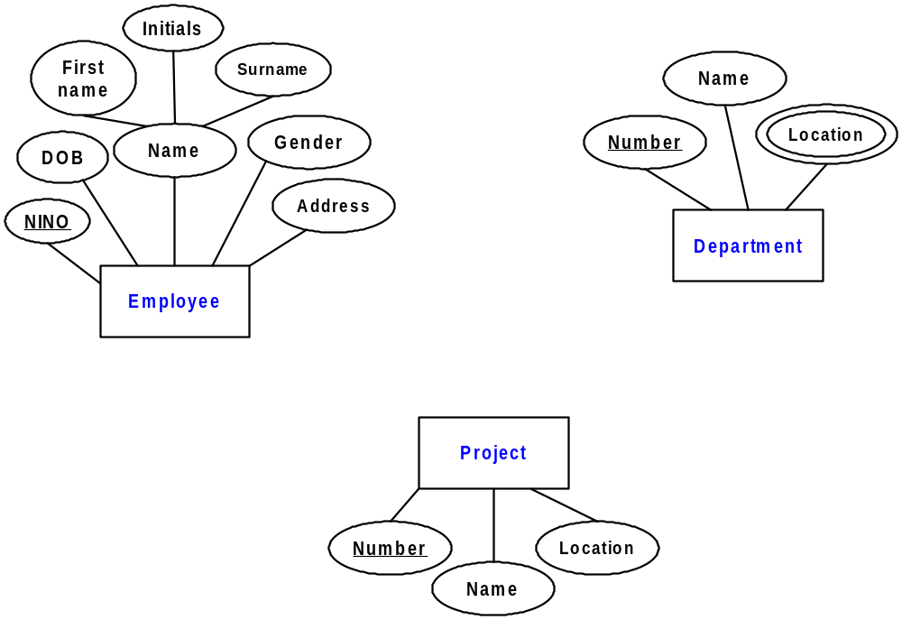
Naff Diagram: Step 1 – Entities and Attributes

Slide 11
Relationships
A relationship is a set of associations among entities from entity types
Informally each relationship instance in R is an association of entities where the association includes exactly one entity from each participating entity type
The degree of a relationship type is the number of participating entities.
A relationship of degree two is called binary whilst one of degree three is called ternary

Slide 12
Relationships as attributes
Relationships are often represented by attributes in the relational model (foreign keys).
Some data models use this idea to replace the concept of relationship
In this approach, foreign keys are not shown on the ER diagram, the relationships are shown by the connection between entities

Slide 13
Role names
An entity that participates in a relationship plays a role in the relationship.
Role names become important where an entity participates more than once in a relationship.
  Consider the recursive relationship SUPERVISION in which EMPLOYEE participates.
  Employees may both supervise and be supervised simultaneously so their participation in the relationship must be identified by a role name

Slide 14
Constraints on Relationship Types
A System will normally have constraints which need to be reflected in the data model
  For example the rule that an employee can only work for one department only.
  A department must have at least 4 employees working in it.
  Such rules should be reflected in the conceptual schema.

Slide 15
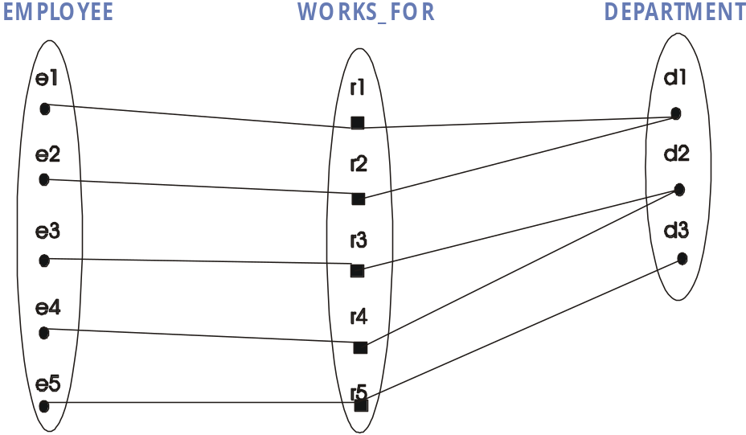
Cardinality Ratio
Specifies the number of relationship instances an entity can participate in.
The WORKS-FOR relationship between EMPLOYEE and DEPARTMENT has a cardinality ratio of 1:N:
  which means that an employee works for no more than 1 department
  and a department may have many employees

Slide 16
Cardinality
The 1:1 relationship MANAGES between EMPLOYEE and DEPARTMENT indicates that a department can only have one manager and a manager may manage only one department
The M:N relationship WORKS-ON with participating entities EMPLOYEE and PROJECT indicates that a project involves many employees and an employee may work on more than one project

Slide 17
Participation Constraint
If an employee must belong to a department then an employee entity can only exist if it participates in a relationship with a department entity.
The participation of an employee in the WORKS-FOR relationship would then be total.
  This is sometime called an existence dependency, or mandatory relationship
Since not all employees are managers, the participation of EMPLOYEE in the MANAGES relationship is said to be partial (or optional).

Slide 18
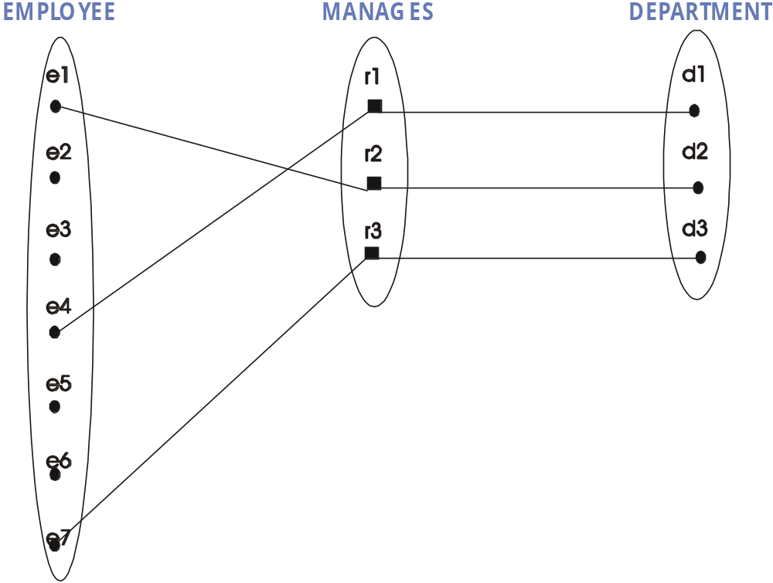
Partial participation
Partial participation of Employee in Manages

Slide 19
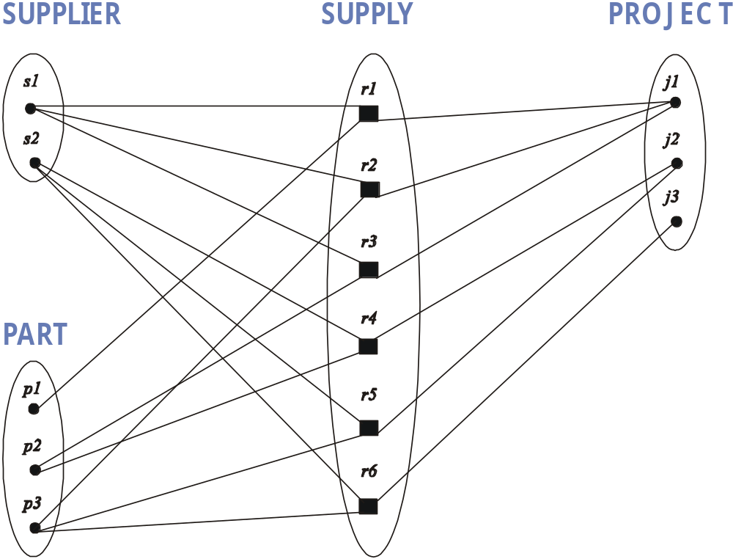
Ternary Instance diagram
Instance diagram to show example occurrences of a ternary relationship.
E.g., Supplier s1 supplies Project j1 with Part p1

Slide 20
Structural Constraints
Cardinality ratio and participation can be lumped together as the structural constraints of a relationship type
Each relationship can be associated with a pair of integers (min, max)
  Given that an entity type E participates in relationship type R the numbers mean that for each entity e in E, e must participate in at least min and at most max relationship instances in R at all times
  Here min = 0 implies partial participation and min > 0 implies total participation

Slide 21
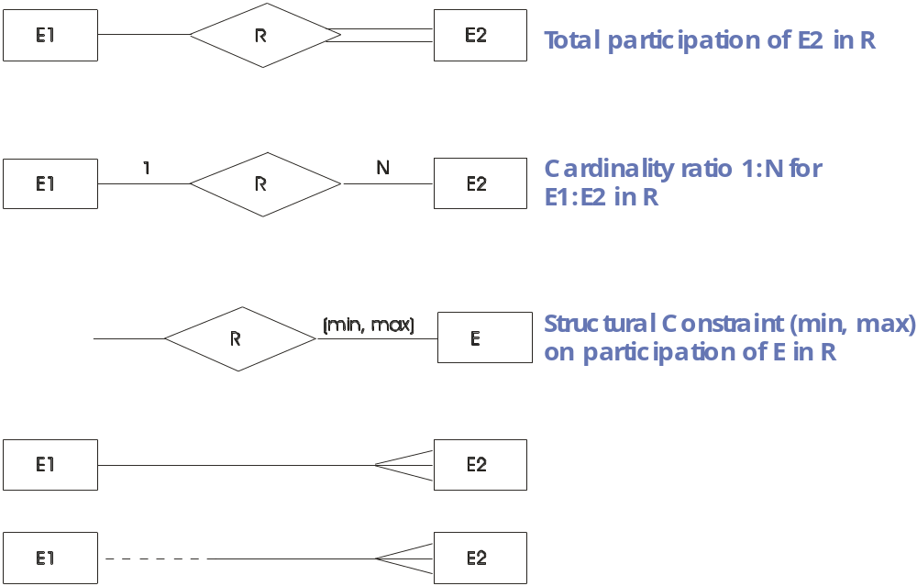
Possibilities for showing structural constraints:

Slide 22
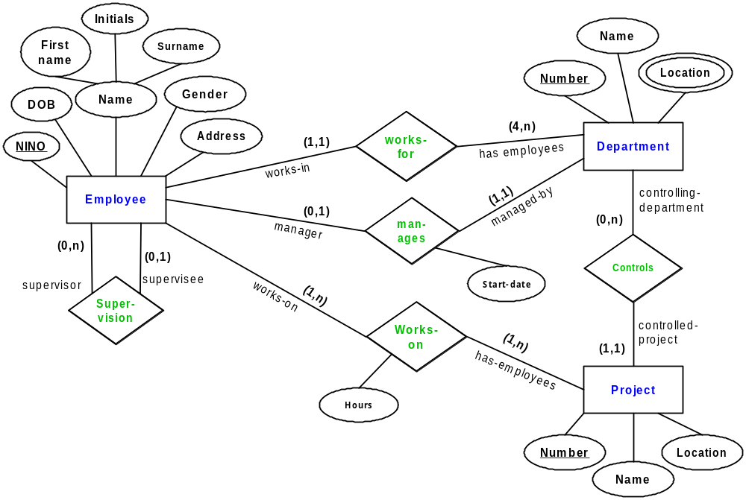
Naff Products: Relationships

Slide 23
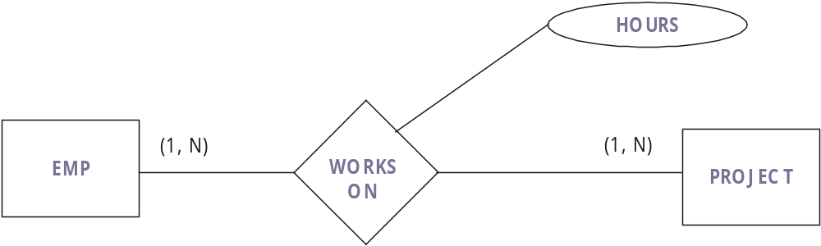
Relationship Attributes
Relationships like entities may possess attributes.
For example the number of hours an employee works on a project

Slide 24
Weak Entity Types (1)
Some entities may not possess key attributes of their own.
These are identified by relating them to entities of another type.
Entities of this other type are called the identifying owner.
The relationship type which links a weak entity type to its owner is called the identifying relationship of the weak entity type.

Slide 25
Weak Entity Types (2)
A weak entity type always has total participation in its identifying relationship.
Consider the entity DEPENDENT. It would be unnatural to assign entities in this set some key such as dependent number, therefore 'JOHN SMITH' might appear twice.
The entities could be distinguished by reference to the employee on which they were dependent

Slide 26
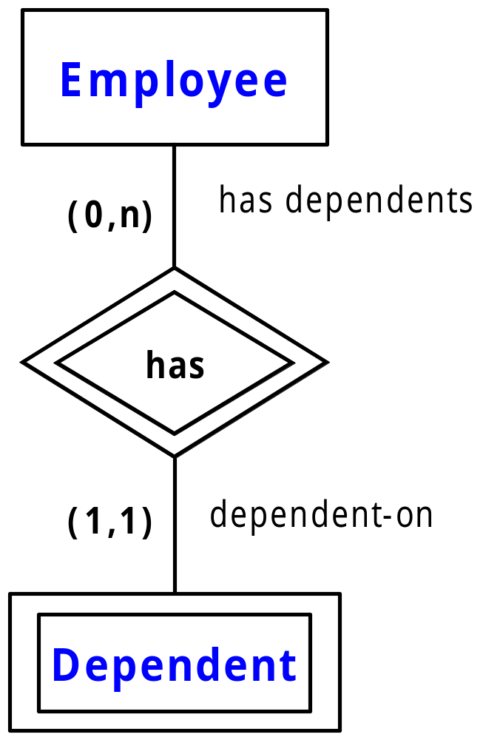
Weak Entity Type Notation
The weak entity is represented by a double rectangle
The identifying relationship is represented by a double diamond

Slide 27
Naff Products relationships
Manages is a 1:1 relationship type between EMPLOYEE and DEPARTMENT
  EMPLOYEE participation is partial.
  DEPARTMENT participation is not specified. Startdate is an attribute of the relationship type.
Works-For is a 1:N relationship type between DEPARTMENT and EMPLOYEE
  Both participations are total
  There is an additional business rule that each department must have a minimum of 4 employees
Controls is a 1:N relationship type between DEPARTMENT and PROJECT
  Participation of PROJECT is total
Works-On is an M:N relationship between PROJECT and EMPLOYEE
  This has the attribute hours

Slide 28
Naff Products relationships (2)
Supervision is a 1:N relationship type between EMPLOYEE and EMPLOYEE (supervisor and supervisee)
  If not all employees have supervisors and not all employees supervise the participation is partial for both roles
Dependants-Of a 1:N relationship type between EMPLOYEE and DEPENDENT
  This is the identifying relationship for the weak entity type DEPENDENT.
  Participation of DEPENDENT is total whilst participation of EMPLOYEE is partial

Slide 29
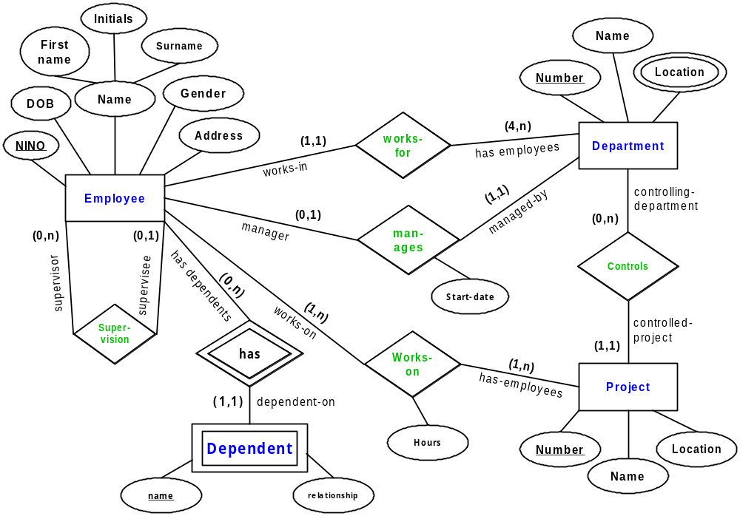
Naff Products
Example
Complete Diagram

Slide 30
Recipe for drawing an ER diagram
Identify the entities
  Give them appropriate names
  Do they depend on any other entity for existence?
Add the attributes
  If an entity has no attributes, then perhaps it is an attribute of something else
Add the relationships
  Do the relationships have any attributes?
Determine the cardinality and whether optional
  If the relationship is optional, then the first figure should be 0, if mandatory, then 1

Slide 31
Summary
Lecture revisited data models
  Overview of different categories
Introduce new notation for ER diagrams
This attempts to capture more of the semantics of the data on the diagram
Also introduces:
  Participation constraints
  Structural constraints
  Relationship attributes
  Weak entity types

